Slide 1
The Achiever
Delta Tau Alpha
October 2015

Slide 2
“Being a leader is not about you. It’s about the people that are on your team
and how you can help them be successful.”
--- Susan Vobejda
Hello,
I hope everyone is having a wonderful semester so far. I have enjoyed
reading the FORM 40 Meeting Reports this semester. It is evident that DTA chapters
across the nation are doing a fantastic job living up to the expectations of Delta
Tau Alpha, emphasizing character development and enhancing undergraduate
preparation for professional positions.
I can not wait to see what the rest of the year has in store for National
Delta Tau Alpha. Please, make sure to send me updates of your local chapter so I can
emphasize your successes in the newsletter. If you have any questions, please
contact me or the other National Council members. Good luck the rest of the year!

Slide 3
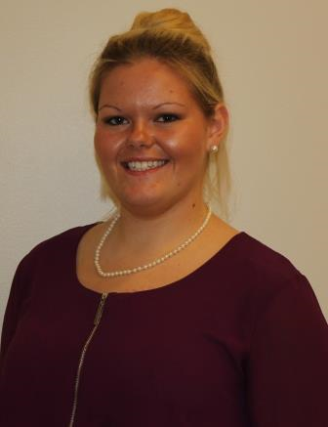
National Officer Spotlight
National Parlimentarian
Deanna Martin
Attends Tennessee Tech University
Double Major in Animal Science and
Agritourism
Founding member of Agritourism
Association
College of Agriculture and Human
Ecology Student Ambassador
Upon graduation, plans to attend
graduate school to earn a Master’s
Degree in Animal Nutrition

Slide 4
National Officer Spotlight
Enjoys fitness, cooking, hiking, and photography
Absolutely loves pigs, coffee, and candles
Deanna hopes to one day work for a leading feed company doing research on feed efficiency and general animal nutrition
In the picture, Deanna is shown speaking to prospective students about the College of Agriculture

Slide 5
FROM ACROSS THE NATION….
Eastern Kentucky University
Initiated 10 new members on Oct. 7th.
Planning a canned food drive for a local church food pantry, and is also planning to contact local vendors to create an agriculture department clothing and product catalogue marketable to members.
Arkansas State University
Held a new member induction ceremony on Oct. 5th.
Planning a laser tag social for the chapter.
The DTA Chapter is sponsoring a T-Post Driving Contest and need volunteers to help set the event up.

Slide 6
FROM ACROSS THE NATION….
College of the Ozarks
Contacted the Salvation Army about assisting with ringing the Christmas bells.
Processing plant manager agreed to donating the prize for the homecoming booth winner.

Slide 7
TAKE NOTE!
DTA Merchandise Available
Fleece Pullovers
Graduation Honor Cords
Graduation Honor Stole
Graduation Medallion
Lapel Pin
T-shirts
Check http://bigcat.edu/agriculture/natdta/merchandise/index.html for more info!

Slide 8
TAKE NOTE!
The National DTA website has been moved to
http://organizations.missouristate.edu/natdta/ though you can still access
the website via its previous location.
Check out the DTA Facebook page at
https://www.facebook.com/nationaldeltataualpha?ref=hl.

Slide 9
MARK YOUR CALENDARS
March 31st – April 2nd, 2016
National DTA Convention
Fort Hays State University

