Slide 1
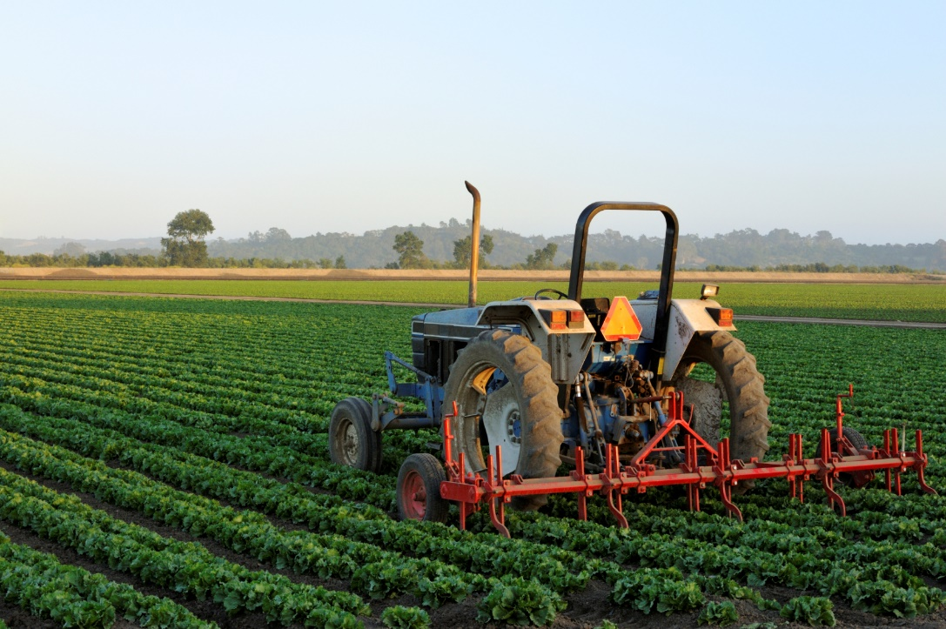
The Achiever
Delta Tau Alpha
November 2015

Slide 2
“Always do your best. What you plant now, you will harvest later.”
---Og Mandino
Hello,
Finals are quickly approaching, and I hope everyone is prepared to make their run for the finish line. I have sincerely enjoyed hearing from several members about their DTA endeavors throughout the semester. I can not wait to see what the rest of the year has in store for National Delta Tau Alpha. Please, make sure to send me updates of your local chapter so I can emphasize your successes in the newsletter. If you have any questions, please contact me or the other National Council members. Good luck the rest of the year!

Slide 3
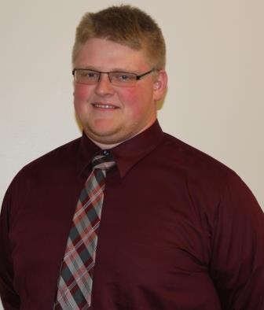
National Officer Spotlight
National Vice-President
Midwest
Josh Harlan
Southeast Missouri State University
Majoring in Agribusiness Animal Science
Plans on pursuing a career in production agriculture
His goal for DTA is to increase activity in less active chapters in the Midwest Region and Nation

Slide 4
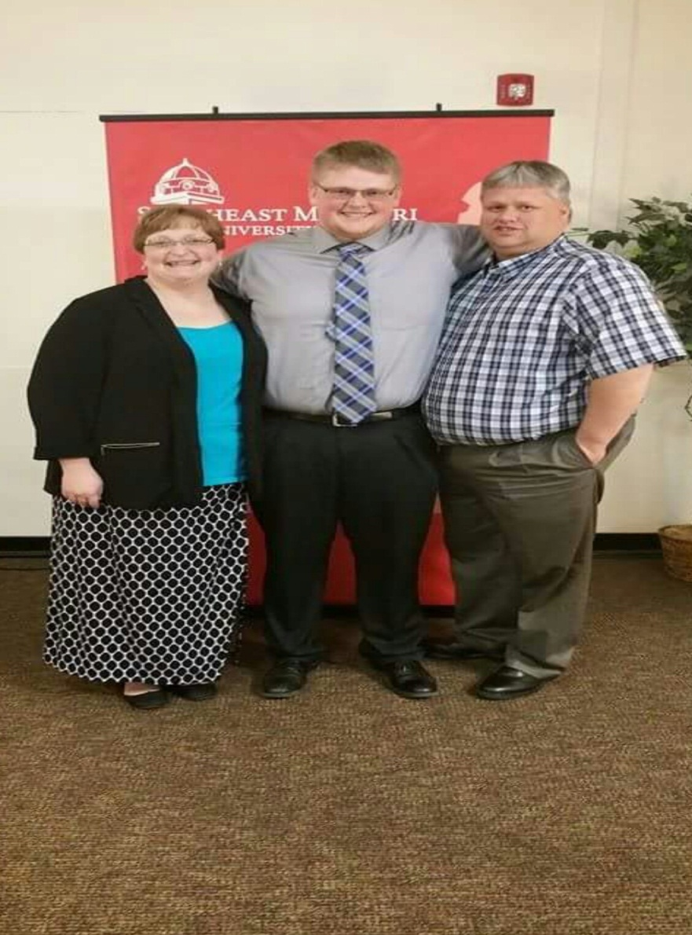
National Officer Spotlight
Involved in Collegiate Farm Bureau, Ag Club, Horticulture Club, Collegiate Cattlemen's, and the Livestock Showing Team
He’s a member of Phi Eta Sigma and Phi Kappa Phi Honor Societies, and the Phi Delta Theta Fraternity
His hobbies include working on the farm/playing with cows, hanging out with friends, and cooking whenever he has time.

Slide 5
FROM ACROSS THE NATION…
Sam Houston State University
Started collecting change for SAAFE House adopt a Family for Christmas.
Made over $1,000 during their annual Haunted House fundraiser.
Arkansas State University
Delivered chapter hats.
Plans on volunteering at the humane society

Slide 6
TAKE NOTE!!!
DTA Merchandise Available
Fleece Pullovers
Graduation Honor Cords
Graduation Honor Stole
Graduation Medallion
Lapel Pin
T-shirts
Check http://bigcat.edu/agriculture/natdta/merchandise/index.html for more info!

Slide 7
TAKE NOTE!!!
The National DTA website has been moved to http://organizations.missouristate.edu/natdta/
though you can still access the website via its previous location.
Check out the DTA Facebook page at https://www.facebook.com/nationaldeltataualpha?ref=hl.

Slide 8
MARK YOUR CALENDARS!!!
March 31st – April 2nd, 2016
National DTA Convention
Fort Hays State University

